Slide 1
Matching Welfare Resources to the Families They Serve
Multi-Agent Decision Support for Social Assistance Officers (SAOs)
Lim Chee Kuen (Danny), 1998459F
Ministry of Social and Family Development
14 August 2026
Singapore Polytechnic AI Champions Bootcamp! · 2026 (SP-600362) – Blended Class 2

Slide 2
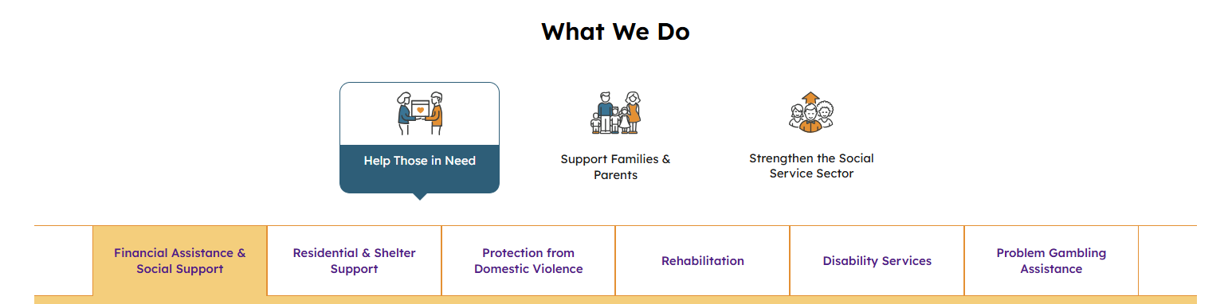
About MSF — what we do
🎯 This capstone addresses Financial Assistance & Social Support — the highlighted tab within Help Those in Need
Source: Ministry of Social and Family Development (msf.gov.sg)

Slide 3
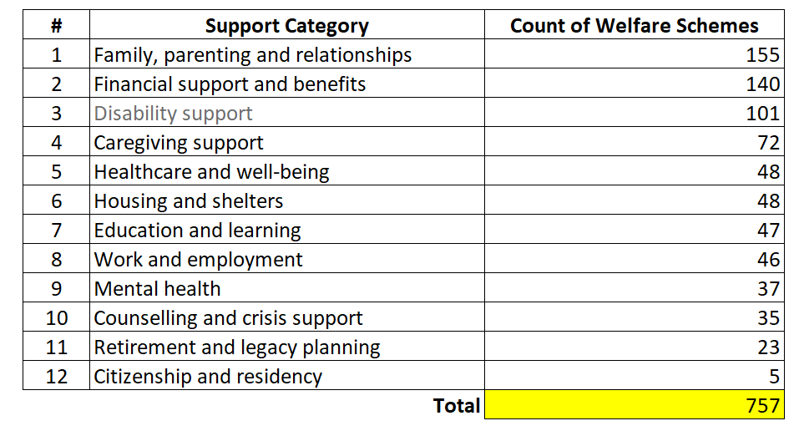
Problem Statement
The gap this project closes
📋 SAOs at MSF sift through 750+ welfare schemes across 12 categories to match each client's unique needs.
⏱️ Manual cross-referencing takes hours per case — shrinking time for real-time conversations and meaningful client engagement.
🎯 How might we surface the right resources instantly, so SAOs can focus on the families they serve?
Distilled from the full 150-word problem-statement paragraph (see samples/problem statement.jpeg for the AI-assisted original)

Slide 4
15 Agents — Deep Analysis Mode · CrewAI Hierarchical Crew (Topic 5.5)
Opt-in multi-agent crew alongside fast single-shot RAG. 3 opt-in Human-in-the-Loop gates give the SAO end-to-end control.
SAO interview note
Stage 0: GovTech CLOAK PII Guard (Topic 5.5.2)
Safety check (Topic 2.6)
HITL #1 (opt-in): SAO reviews AI's case breakdown
Toggle in sidebar · Topic 2.6
CrewAI Hierarchical Crew (Topic 5.5)
Triaging Agent
reads case · picks 2–4 of 12 categories
← 1 LLM call (gpt-4.1-mini)
Financial
agent
Family
agent
Caregiving
agent
Healthcare
agent
Mental Health
agent
Crisis
agent
Only the 2–4 agents picked by the Triaging Agent actually run (in parallel).
Disability
agent
Youth
agent
Education
agent
Housing
agent
Senior
agent
Employment
agent
Each agent uses a category-filtered retriever as a CrewAI Tool (dense + HyDE + BM25 + RRF) — Topic 5.5 §Tools
AGGREGATOR Agent (#14)
ranks top-5 with verbatim citations
HITL #2
(opt-in)
review top-5
CASE DOCUMENTATION OFFICER Agent (#15)
plain-English summary (family + record)
← 2 LLM calls (Aggregator, then Docs)
Faithfulness Audit (Topic 4.4)
HITL #3 (opt-in) : SAO reviews AI's case documentation
Fast single-shot RAG (v1.3) remains the production default. Deep Mode opt-in via sidebar toggle. ~$0.02/query · ~25-30 sec · Topic 5.5 mastery demonstrated.

Slide 5
GovTech Privacy Toolkit: CLOAK (Stage 0 PII Protection)
Singapore's Whole-of-Government privacy toolkit · Topic 5.5.2
🔐 How the key handshake works
🌐 PUBLIC KEY
Like your username — sent in every request header.
Identifies WHO the request is from. Safe if intercepted.
🔒 PRIVATE KEY
Like your password — NEVER sent over the network.
Stays local; used to sign each request with a unique fingerprint.
🕯️ Think of a wax seal: only your ring makes it, it cracks if the letter changes, and it expires at midnight.
🛡️ What CLOAK redacts (7 Singapore-tuned entities)
Entity type | Original example | Replaced with
PERSON | Mdm Kim Harin | <PERSON>
SG_NRIC_FIN | S8273756Y | <SG_NRIC_FIN>
PHONE_NUMBER | 8123 4567 | <PHONE_NUMBER>
EMAIL_ADDRESS | kim@gmail.com | <EMAIL_ADDRESS>
SG_BANK_ACCOUNT_NO | DBS 011-12345-6 | <SG_BANK_ACCOUNT_NO>
SG_ADDRESS | Blk 25 Sin Ming Rd | <SG_ADDRESS>
DATE_TIME | born 3 April 1978 | <DATE_TIME>
⚠️ Fail-CLOSED (Topic 2.7): if CLOAK is unreachable or keys are missing, the request FAILS — raw PII is never passed through to the LLM.
1 CLOAK call per query · ~300 ms latency · $0 cost · fixed at Stage 0 of the pipeline

Slide 6
Social Assistance Delivery Process (pain points)
Stage 0
Stage 1
Stage 2
Stage 3
Stage 4
Stage 5
Client's application
Intake, prelim. assess. & action planning
Detailed assessment & fact-checking
Intervention planning
Recommendations
Handholding and review (if necc.)
ID gap in supporting docs.
Engage client & gather info
Do SSNet1 screening
Determine client's eligibility
Put proposals in SSNet1 for AO to approve
Asess. client's circumstances
Check supporting documents
📁 Client #1
OCV report
Create SMART goals
Verify info w/ other agencies
Bank statements
Utilities bill
Conduct home visits
ID document
MC/Termination letter
📁 Client #2
Use case
Pain point #2:
SAO's manual review of high vol. docs
SAO need to manually review through all submitted documents to determine if candidate client is eligible or not for the applied specified welfare scheme.
Pain point #3:
Welfare officers are mentally taxed to determine which of the many welfare resources in public website (https://supportgowhere.life.gov.sg/) are applicable/relevant for each client's unique needs.
SAO spend precious hours on administrative tasks – reading, analyzing, and resource hunting – instead of building relationships and providing direct support to families.
Pain point #4:
SAO faces the burden of manually reviewing case notes (interview notes for client) during engagement sessions
to determine suitable goals across the various outcome indicators (KPI)s.

Slide 7
Improve productivity of resource matching
for Social Assistance Officers

Slide 8
Legend — File categories
Each row in the next slides is tagged with one of these four roles.
Core application
Data-pipeline scripts
Modules used on every recommendation request: LLM wrapper, prompt templates, retriever, recommender, Streamlit UI. The runtime path.
Run once (or on a schedule) to build the SGW corpus: scrape, chunk, embed, topic-map, patch missing items. Read-then-write.
Diagnostics / one-off probes
Config & data
Forensics scripts kept in the repo for transparency: DOM probes, gap diagnoses, sample inspector. Help auditors trust the pipeline.
Environment + persisted artefacts: requirements.txt, .env (gitignored), .gitignore, the data/ tree with raw JSON, chunks, embeddings.

Slide 9
Stage 0 · Project setup
Environment, secrets and version control — laid down before anything else runs.
# | File / Action | What it does | Bootcamp topic(s) | Category
0a | requirements.txt | Pip deps pinned: playwright, openai, python-dotenv, numpy, streamlit. | Topic 6.2 — pip + venv | Config & data
0b | .venv/ (python -m venv) | Isolated Python environment so global Python stays untouched. | Topic 6.2 — pip + venv | Config & data
0c | .env (gitignored) | OPENAI_API_KEY=… loaded by python-dotenv at import time. | Topic 5.2 — Secure credentials | Config & data
0d | .gitignore | Excludes .venv/, .env, __pycache__/ from version control. | Topic 8.3 — Intro to Git & GitHub | Config & data

Slide 10
Stage 1 · Data acquisition
One-time build of the SupportGoWhere corpus: 307 records / 2,147 section chunks / 12 category mappings.
# | File / Action | What it does | Bootcamp topic(s) | Category
1 | scraper.py | Playwright renders 296 /schemes/ + /services/ pages; saves cleaned text per record. | Topic 5.3 — Python scripts · Topic 2.7 — Exception handling | Data-pipeline scripts
2 | chunker.py | Splits each record into section-level chunks (tagline / highlights / who / apply / help / expect / whole). | Topic 4.2 — Pre-Retrieval · Topic 1.3 — Delimiters | Data-pipeline scripts
3 | embed.py | Embeds all 2,147 chunks via text-embedding-3-small; saves vectors.npy + index.jsonl. | Topic 3.1 — Embeddings · Topic 3.2 — Handling Embeddings | Data-pipeline scripts
4 | topic_mapper.py | Crawls the 12 /topics/<slug> pages, captures XHR JSON to derive category metadata per record. | Topic 4.2 — Pre-Retrieval (metadata enrichment) | Data-pipeline scripts
4b | scrape_missing.py | Patch scraper for items present on topic pages but absent from the original sitemap (11 found). | Topic 4.5 — RAG Evaluation (coverage check) | Data-pipeline scripts

Slide 11
Stage 2 · Application layer
Runtime modules called on every recommendation request. Designed to be imported anywhere — CLI, Streamlit, future API.
# | File / Action | What it does | Bootcamp topic(s) | Category
5 | llm.py | Thin OpenAI wrapper: get_completion() (chat) + embed_batch() (vectors); loads key from .env. | Topic 1.3 — f-strings · Topic 5.2 — Credentials · Topic 2.7 — Exceptions | Core application
6 | prompts.py | CO-STAR template builder; XML-tag delimited candidate rendering. | Topic 1.2 — Prompt Engineering · Topic 1.3 — Delimiters · Topic 2.5 — Multi-action · Playbook p.26 (CO-STAR) | Core application
7 | retriever.py | Loads vectors + index + topic map; search() does cosine + dedup + filter; returns typed Result objects. | Topic 3.3 — Applying Embeddings · Topic 3.4 — RAG · Topic 4.3 — Improving Retrieval | Core application
8 | recommender.py | End-to-end UC#1: retrieve → render → generate → parse; returns RecommendationResponse. | Topic 2.6 — Prompt Chaining · Topic 4.4 — Post-Retrieval · Topic 2.7 — Exceptions | Core application

Slide 12
Stage 3 · UI
The SAO-facing surface. Built lightweight so we can iterate fast and deploy to Streamlit Community Cloud later.
# | File / Action | What it does | Bootcamp topic(s) | Category
9 | app.py | Streamlit UI: sidebar filters (category / kind / pool size), sample queries, recommendation cards with rationale + evidence + eligibility flags, debug panels. | Topic 6.1 — Understanding Streamlit · Topic 6.3 — Working with Streamlit · Topic 8.1 — Streamlit Deep Dive (state, @st.cache_resource) | Core application
What the SAO sees at runtime
Enter a 1–2 sentence client situation → optional filters → Top-N recommendations with fit-score, plain-English rationale, verbatim evidence quote from SGW, and a checklist of items the SAO should verify with the client. Each card links straight to the live SupportGoWhere page.

Slide 13
Stage 4 · Diagnostics & probes
One-off scripts kept in the repo so any reviewer can re-run the forensics that informed our design decisions.
# | File / Action | What it does | Bootcamp topic(s) | Category
D1 | probe_dom.py | Initial DOM-structure investigation (homepage + scheme + service pages). | Topic 8.5 — Vibe coding (exploratory probing) | Diagnostics / one-off probes
D2 | probe_topic.py | Topic-page DOM probe (revealed that cards are JS-routed buttons, not anchors). | Topic 8.5 — Vibe coding | Diagnostics / one-off probes
D3 | diagnose_topic.py · find_missing.py | Per-topic gap diagnosis — surfaced 11 items present on SGW but absent from our sitemap. | Topic 4.5 — RAG Evaluation (coverage) | Diagnostics / one-off probes
D4 | inspect_corpus.py | Pretty-print sample records for eyeball QA on chunk + scrape quality. | Topic 4.5 — RAG Evaluation | Diagnostics / one-off probes

Slide 14
Stage 5 · Planned
Where the project goes next — already aligned to Weeks 4–9 of the bootcamp.
# | File / Action | What it does | Bootcamp topic(s) | Category
10 | evaluator.py | Ground-truth pairs (~10 client scenarios → expected schemes) + retrieval@k metric + LLM-judge ranking. | Topic 4.5 — RAG Evaluation | Core application
11 | doc_parser.py · rules_extractor.py · eligibility_checker.py | UC#2 (Pain Point #2) — extract structured facts from uploaded client docs, match against the 'who' / 'apply' chunks already in our corpus. | Topic 2.5 — Multi-action · Topic 2.6 — Chaining · Topic 4.4 — Post-Retrieval | Core application
12 | Streamlit Cloud deployment | Push repo to GitHub, set OPENAI_API_KEY as a Streamlit secret, optional password protection. | Topic 8.2 — Password Protect · Topic 8.3 — Git / GitHub · Topic 8.4 — Deploy to Community Cloud | Config & data

Slide 15
Bootcamp curriculum coverage
Every topic block the bootcamp teaches has a corresponding artefact in the repo.
Week / Topic | What the bootcamp teaches | Where it lives in the Claude vibe coding repo
Week 1 | LLM foundations · Prompt Engineering · CO-STAR · Tokens · Hallucinations | llm.py · prompts.py · faithfulness_check.py
Week 2 (2.4 / 2.5) | Reasoning · Chain-of-Thought · Least-to-Most decomposition | decomposer.py · recommender.py (reasoning_steps in JSON schema)
Week 2 (2.6) | Decision Chain: safety check · query router | safety.py · router.py · recommender.py (Stage 1-2)
Week 2 (2.6) — HITL | Human-in-the-Loop as part of the workflow (3 gates) | app.py: HITL #1 case breakdown · #2 top-5 (Agent #14) · #3 case docs (Agent #15)
Week 2 (2.7) | Exception handling · Fail-CLOSED design | pii_filter.py · safety.py · recommender.py (rate-limit / auth guards)
Week 3 (3.x) | Embeddings · Vector search · RAG · Beyond keywords | embed.py · retriever.py · bm25_retriever.py (hybrid) · hyde.py
Week 4 (4.x) | Advanced RAG · Pre / Post-retrieval · Faithfulness audit · Eval | chunker.py · hyde.py · faithfulness_check.py · ragas_eval.py
Week 5 (5.x) | Agents · Multi-agent orchestration · Secure credentials | crew_runner.py (CrewAI · 15 agents) · llm.py get_secret() · .env / st.secrets
Week 5 (5.5) | CrewAI multi-agent: Triaging · 12 specialists · Aggregator · Case Doc Officer | crew_runner.py · agents_config.py · recommender.py _recommend_deep_mode()
Week 5 (5.5.2) | CLOAK Free-Text Anonymisation (WOG PII toolkit) | pii_filter.py (Stage 0 · fail-CLOSED · CLOAK-AUTH HMAC signing)
Week 6 (6.x) | Streamlit basics · pip + venv · Debugging | requirements.txt · .venv/ · app.py
Week 8 (8.x) | Streamlit Deep Dive · Password gate · Git · Deploy · Vibe coding | app.py (@st.cache_resource, session_state) · Streamlit Cloud deployment
Capstone deadline: 14 August 2026 · Politemall

